Slide 1
Database Commute Times
Nshalati Mboweni

Slide 2
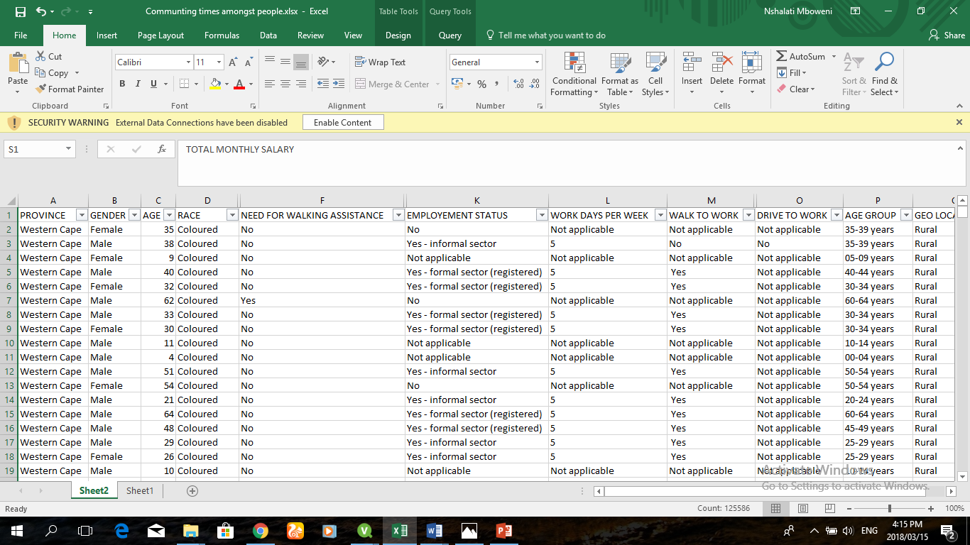
Commute Times Dataset

Slide 3
Background
My dataset is about the commuting times of employed and unemployed users from all nine provinces in south Africa. It outlines and lists people that walk to work, drive to work and commuters who work in either formal sector or informal sector.
Using the data set I firstly focused on demographics of everyone who lives in each province by categorising them using gender.
Thereafter I considered the geographical area that they are based in which can be categorised by rural area, metropolitan area or urban area.
After careful analysis of the data I was able to check number of people that walk to work, drive to work and where each commuter works.

Slide 4
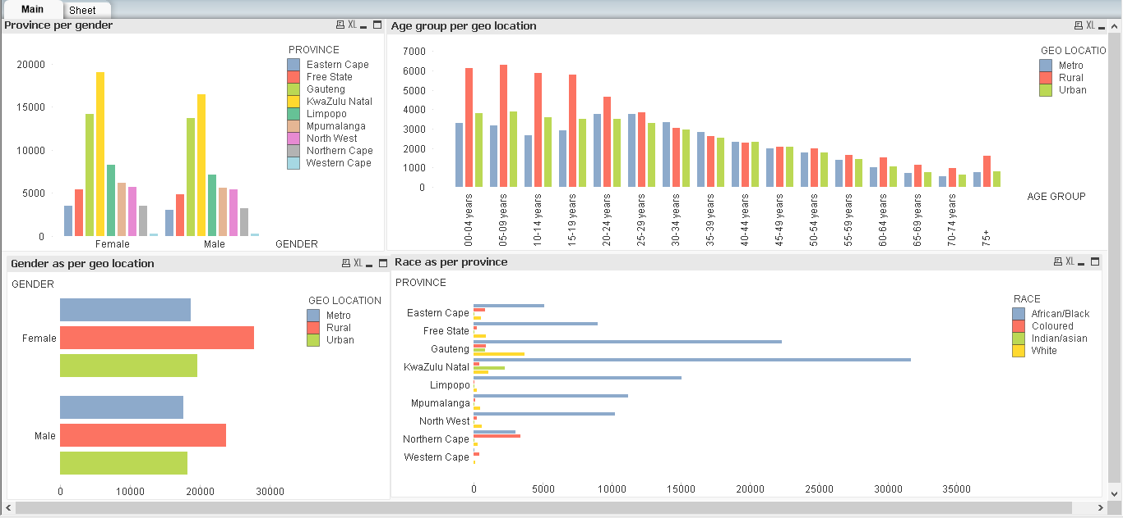
Demographics

Slide 5
Conclusion for Demographics
For both male and female commuters they had the highest number in the KZN province.
Highest number of males and females are found in the rural areas where most people make use of some form of transport which can either be driving or walking to work.
The demographics will help understand and figure out how many people I will be dealing with and from which province exactly.

Slide 6
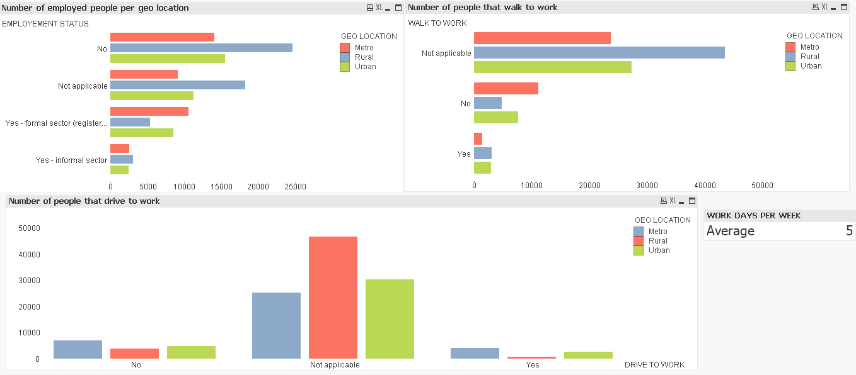
Drive to work vs. Walking to work

Slide 7
Conclusion for Driving vs Walking
The dataset included even people that were not working so some of the questions did not relate to the people that it was asked.
The not applicable part or portion was for all the people that neither worked, drove or walked to work hence that is why they have a higher ranking in almost all questions asked.
The rural area had the lowest number of people that drove because since the rural area consists of mostly gravel roads its bound to damage cars.
The metropolitan area had a higher rate of people that don’t drive because since they live in a city they are surrounded by taxis right at their door step.

